Slide 1
A Smart Phone Application for Valet Parking
LUO Xianyang, Supervised by Dr. Chim

Slide 2
Outline
Introduction
Related Works
Design
Implementation
Future Plan
Demo

Slide 3
Introduction
Why valet parking
Disadvantages of traditional valet parking
Project description

Slide 4
Why Valet Parking
Do not need to find a parking lot
Do not need to walk a long distance
Park more cars into a given space

Slide 5
Disadvantages of traditional valet parking
Must use a valet ticket
Time to fulfill the ticket
May lose the ticket
May not know the drop-off point
Pay in cash or octopus

Slide 6
Project Description
This project mainly focuses on helping drives enjoy better valet parking service with high efficiency and great user experience
Main functions
Register / Login
Add/ Edit/ Delete a car
Place an order in a few seconds
Redeem the car by just tapping a button

Slide 7
Related Works
Luxe
Youbo

Slide 8
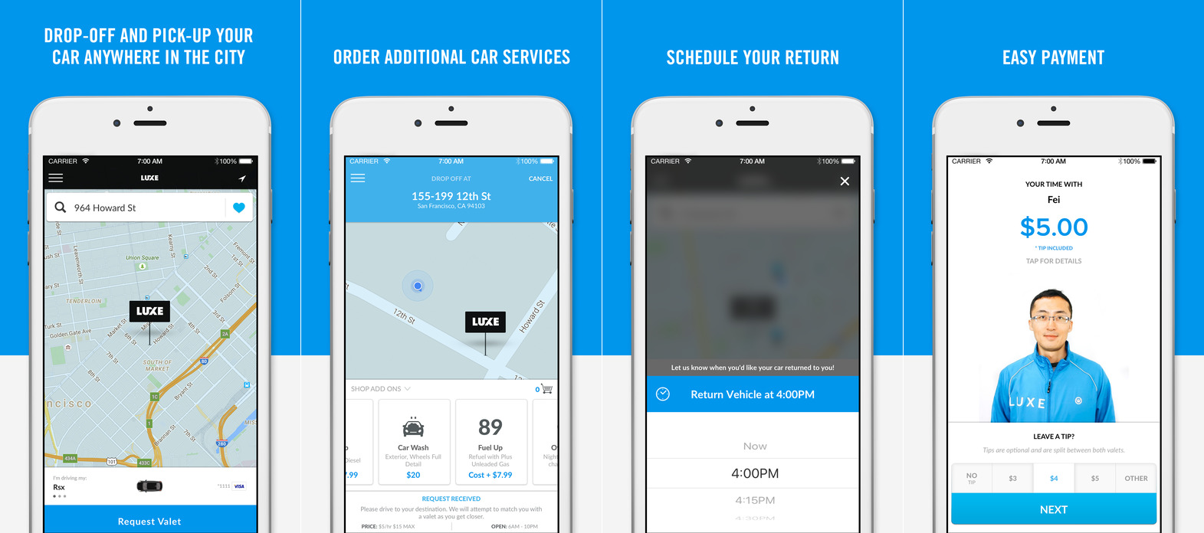
Luxe
Advantages
Drop off anywhere
Mobile payment
Additional car service (wash, refuel)
Disadvantages
Registration process is complicate
No new technology like 3D touch
Notes:
iOS / Android, the USA

Slide 9
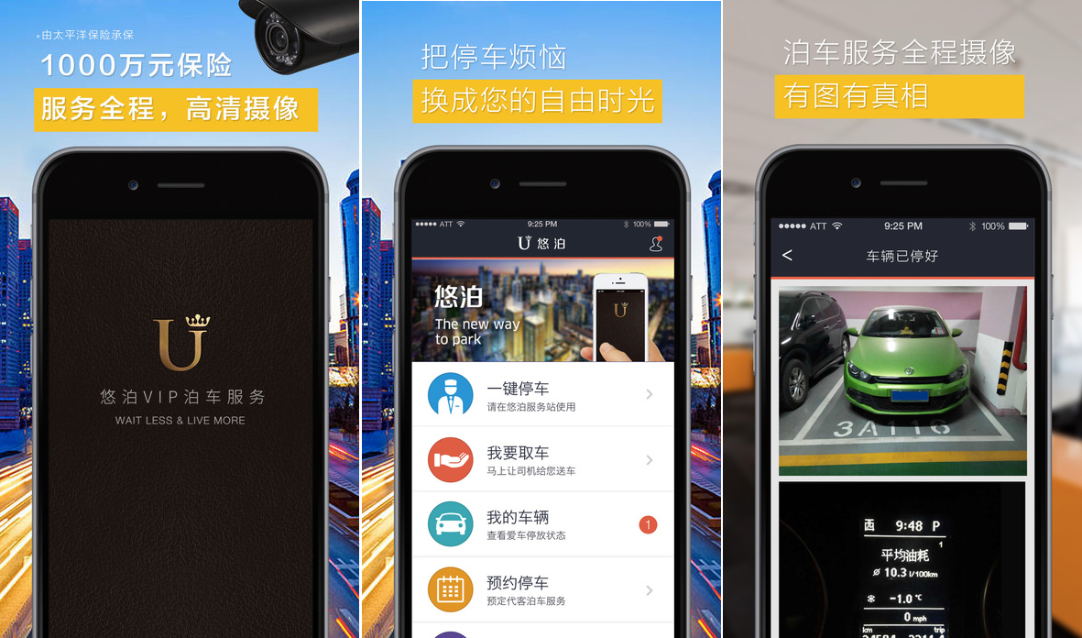
Youbo
Advantages
Get the car returned wherever customers want
Additional car service
Shows car status
Disadvantages
User interface not so good
No navigation
Notes:
iOS / Android, mainland China

Slide 10
Design
System Architecture
Workflow
UML Analysis
Use case diagram
Class diagram
UI design
Welcome pages
Main function pages

Slide 11
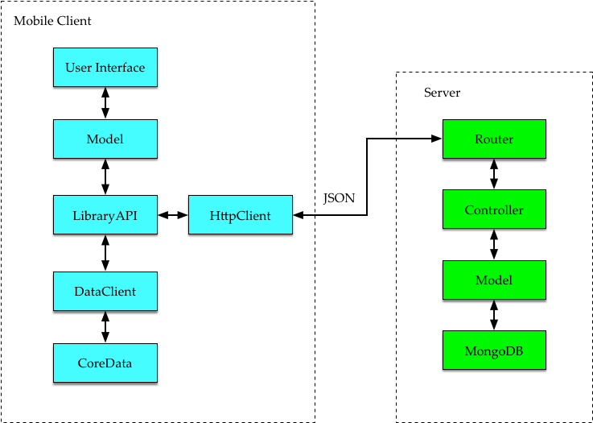
System Architecture
Notes:
Two sides: front-end and back-end. Back-end is based on Node.js and MongoDB

Slide 12
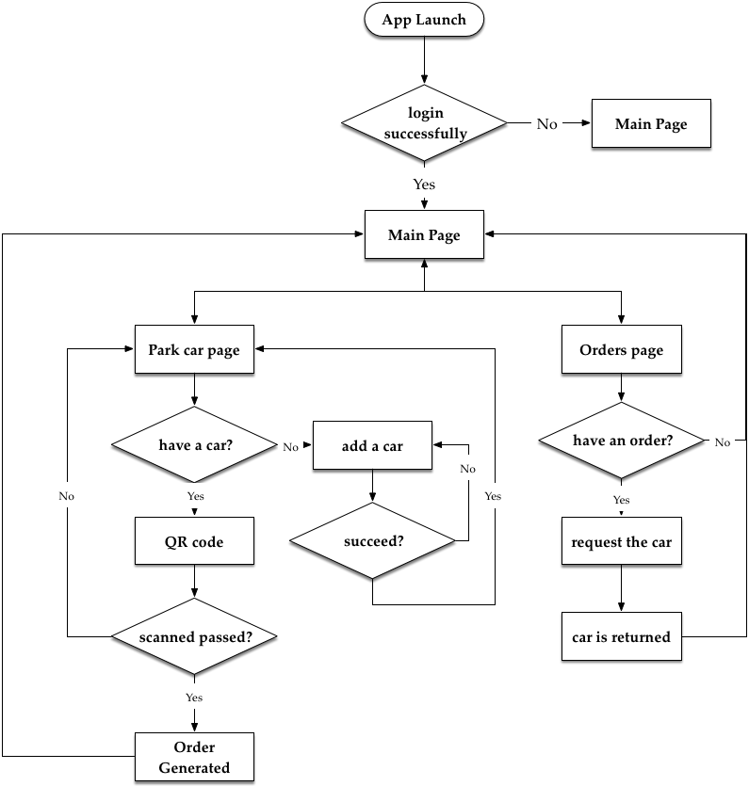
Workflow

Slide 13
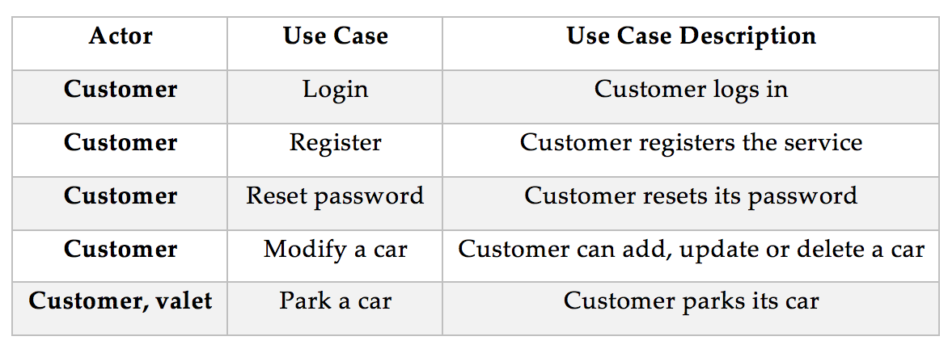
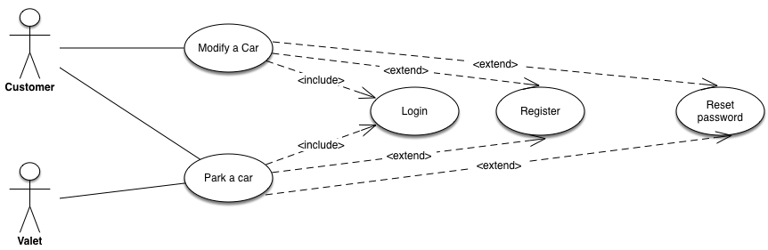
Use Case Diagram

Slide 14
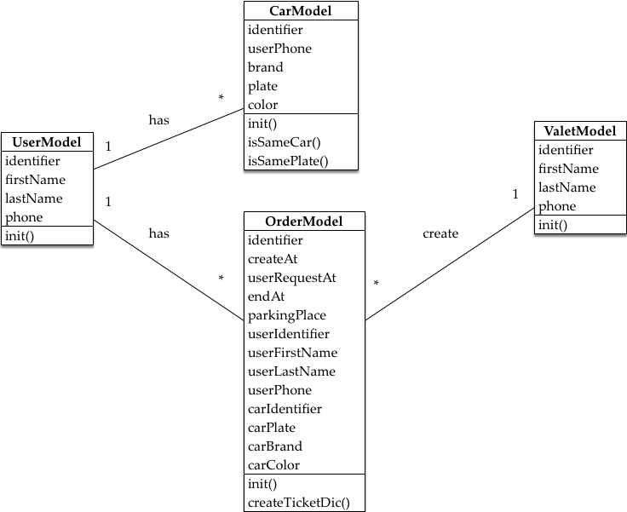
Class Diagram

Slide 15
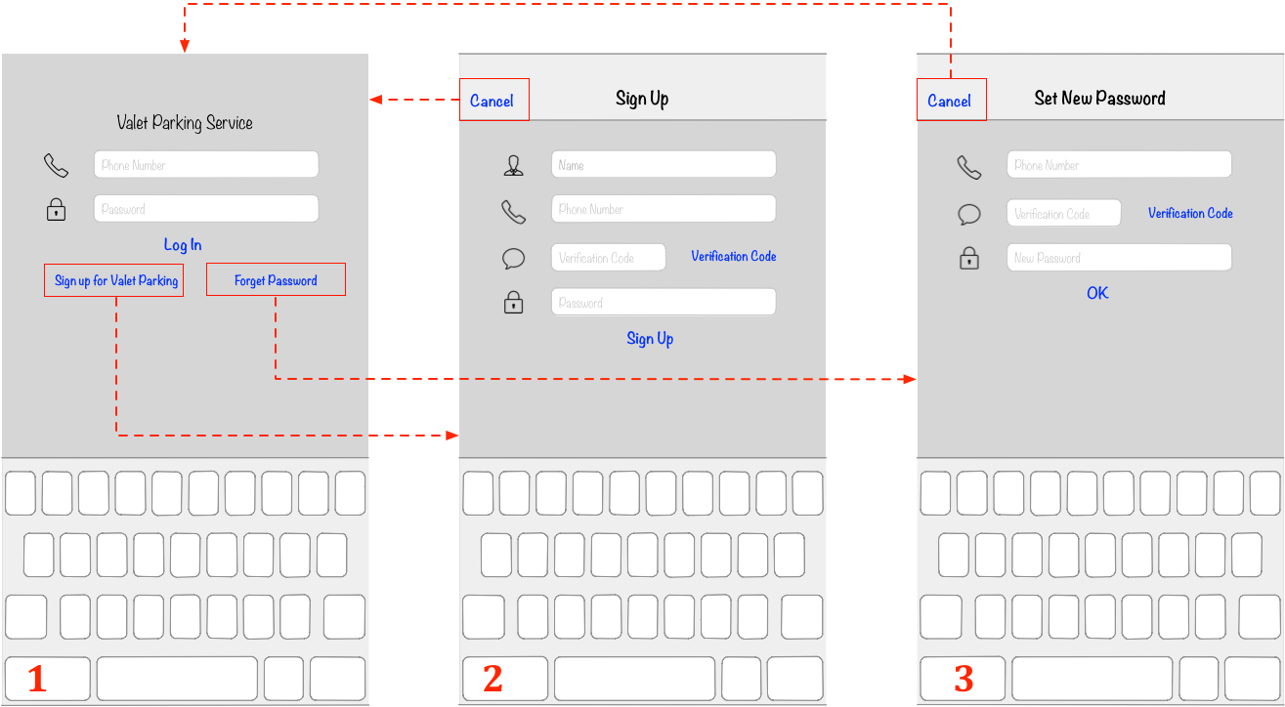
UI Design – Welcome Pages

Slide 16
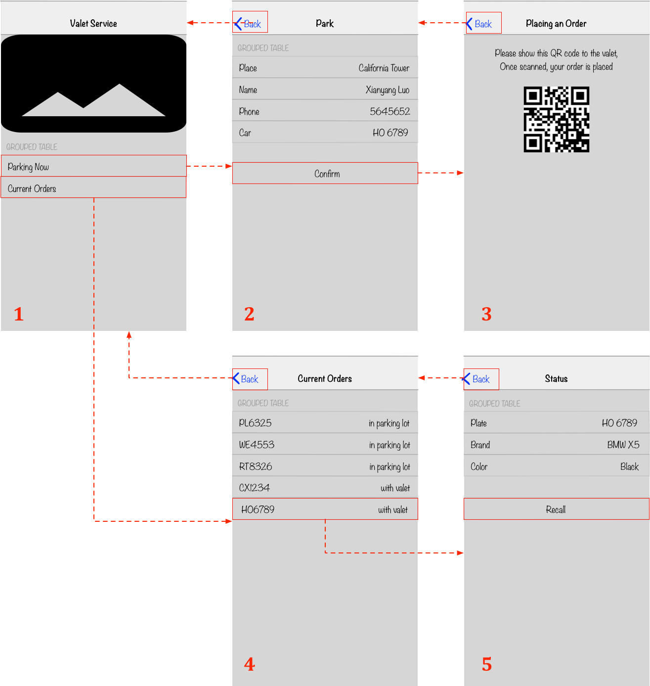
UI Design – Main Function Pages

Slide 17
Implementation
Hardware Configuration
Implementation of server
Implementation of mobile clients
Customer side
Valet side

Slide 18
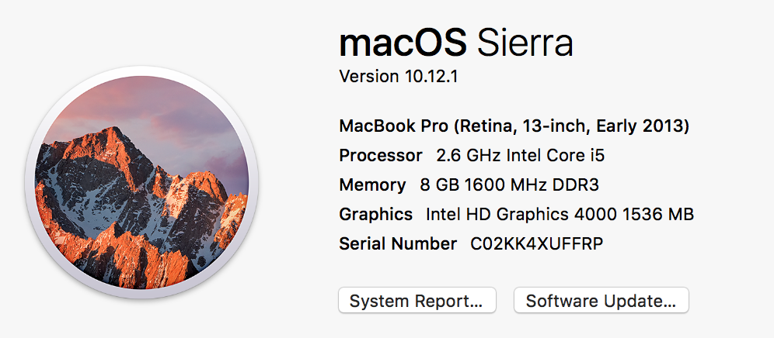
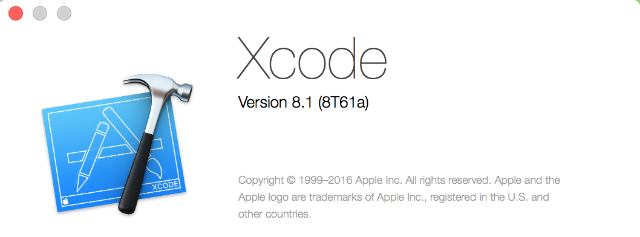
Hardward Configuration

Slide 19
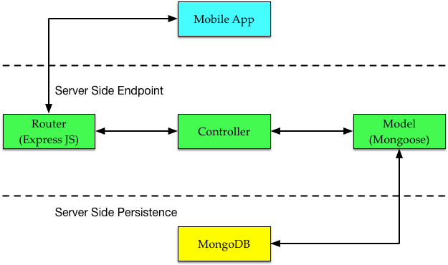
Implementation of Server
Node.js (v4.6.0)
MongoDB (v2.1.0)
Mongoose (v4.0.6)

Slide 20
Implementation of Customer Client
MVC design pattern
Main Controllers
LibraryAPI (singleton pattern)
HttpClient
DataClient
Models
Customer
Order
Car
Views

Slide 21
Main Controllers
LibraryAPI inherits from NSObject and handles all the data reqeust
Class method sharedInstance().
Example: [[LibraryAPI sharedInstance] getCurrentUserModel];
HttpClient handles all the http request
Afnetworking
DataClient handles all the local data request
CoreData (native iOS)

Slide 22
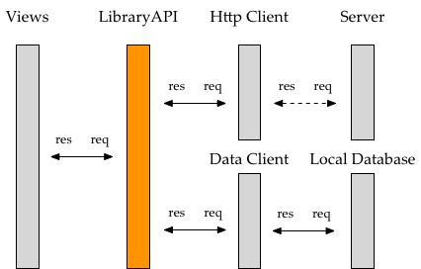
Main Controllers

Slide 23
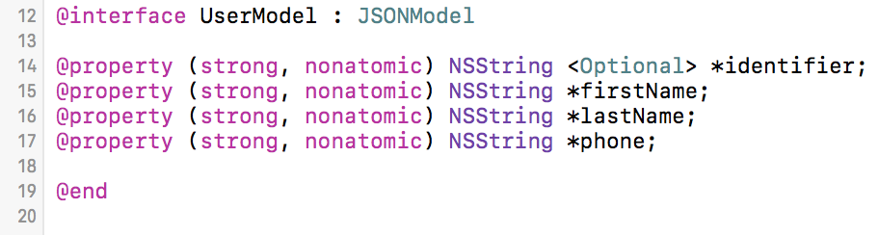
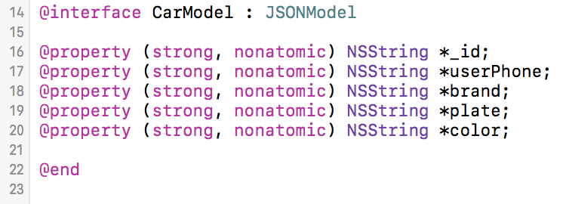
Models
All models inherit from JSONModel
UserModel
Name
Phone
Car
Plate
Brand
Color
Order

Slide 24
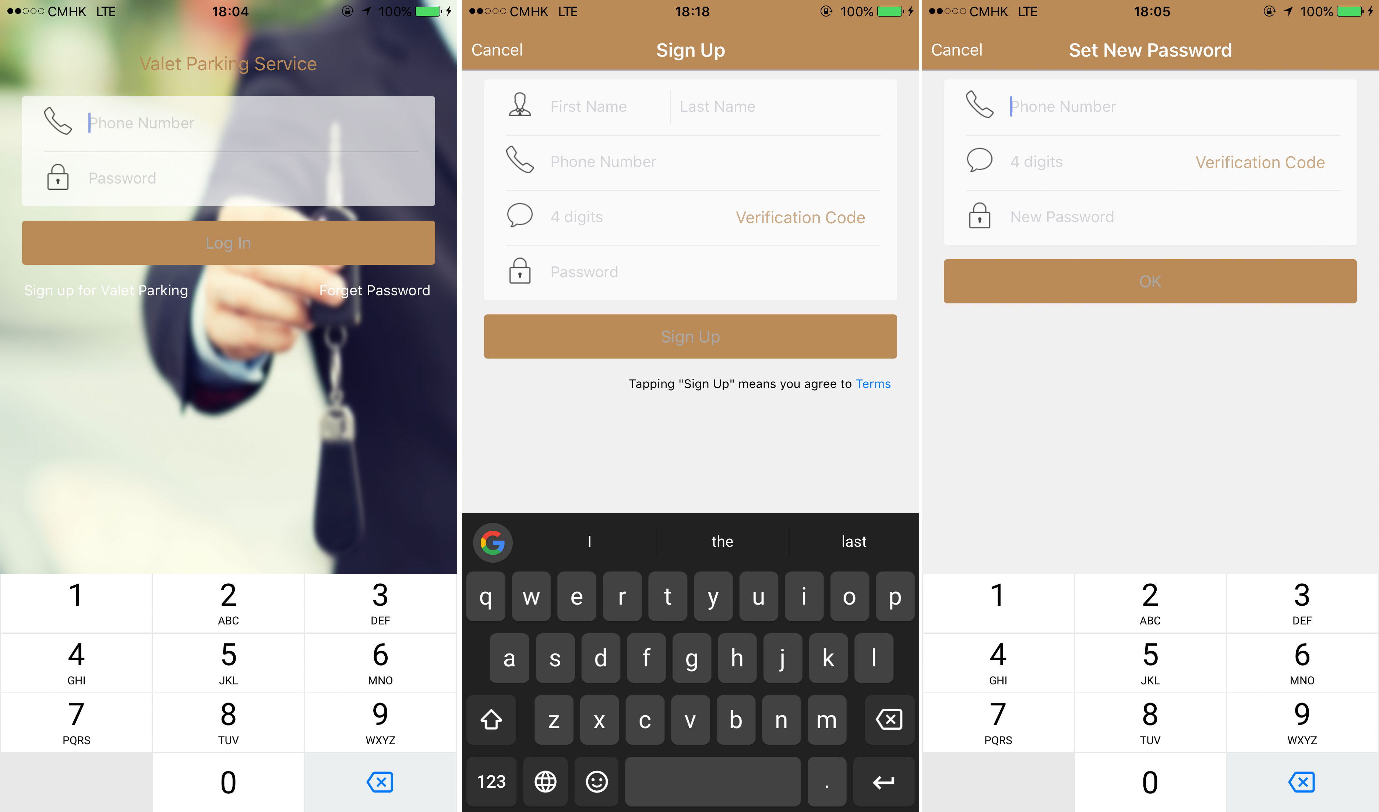
Views – Welcome Views

Slide 25
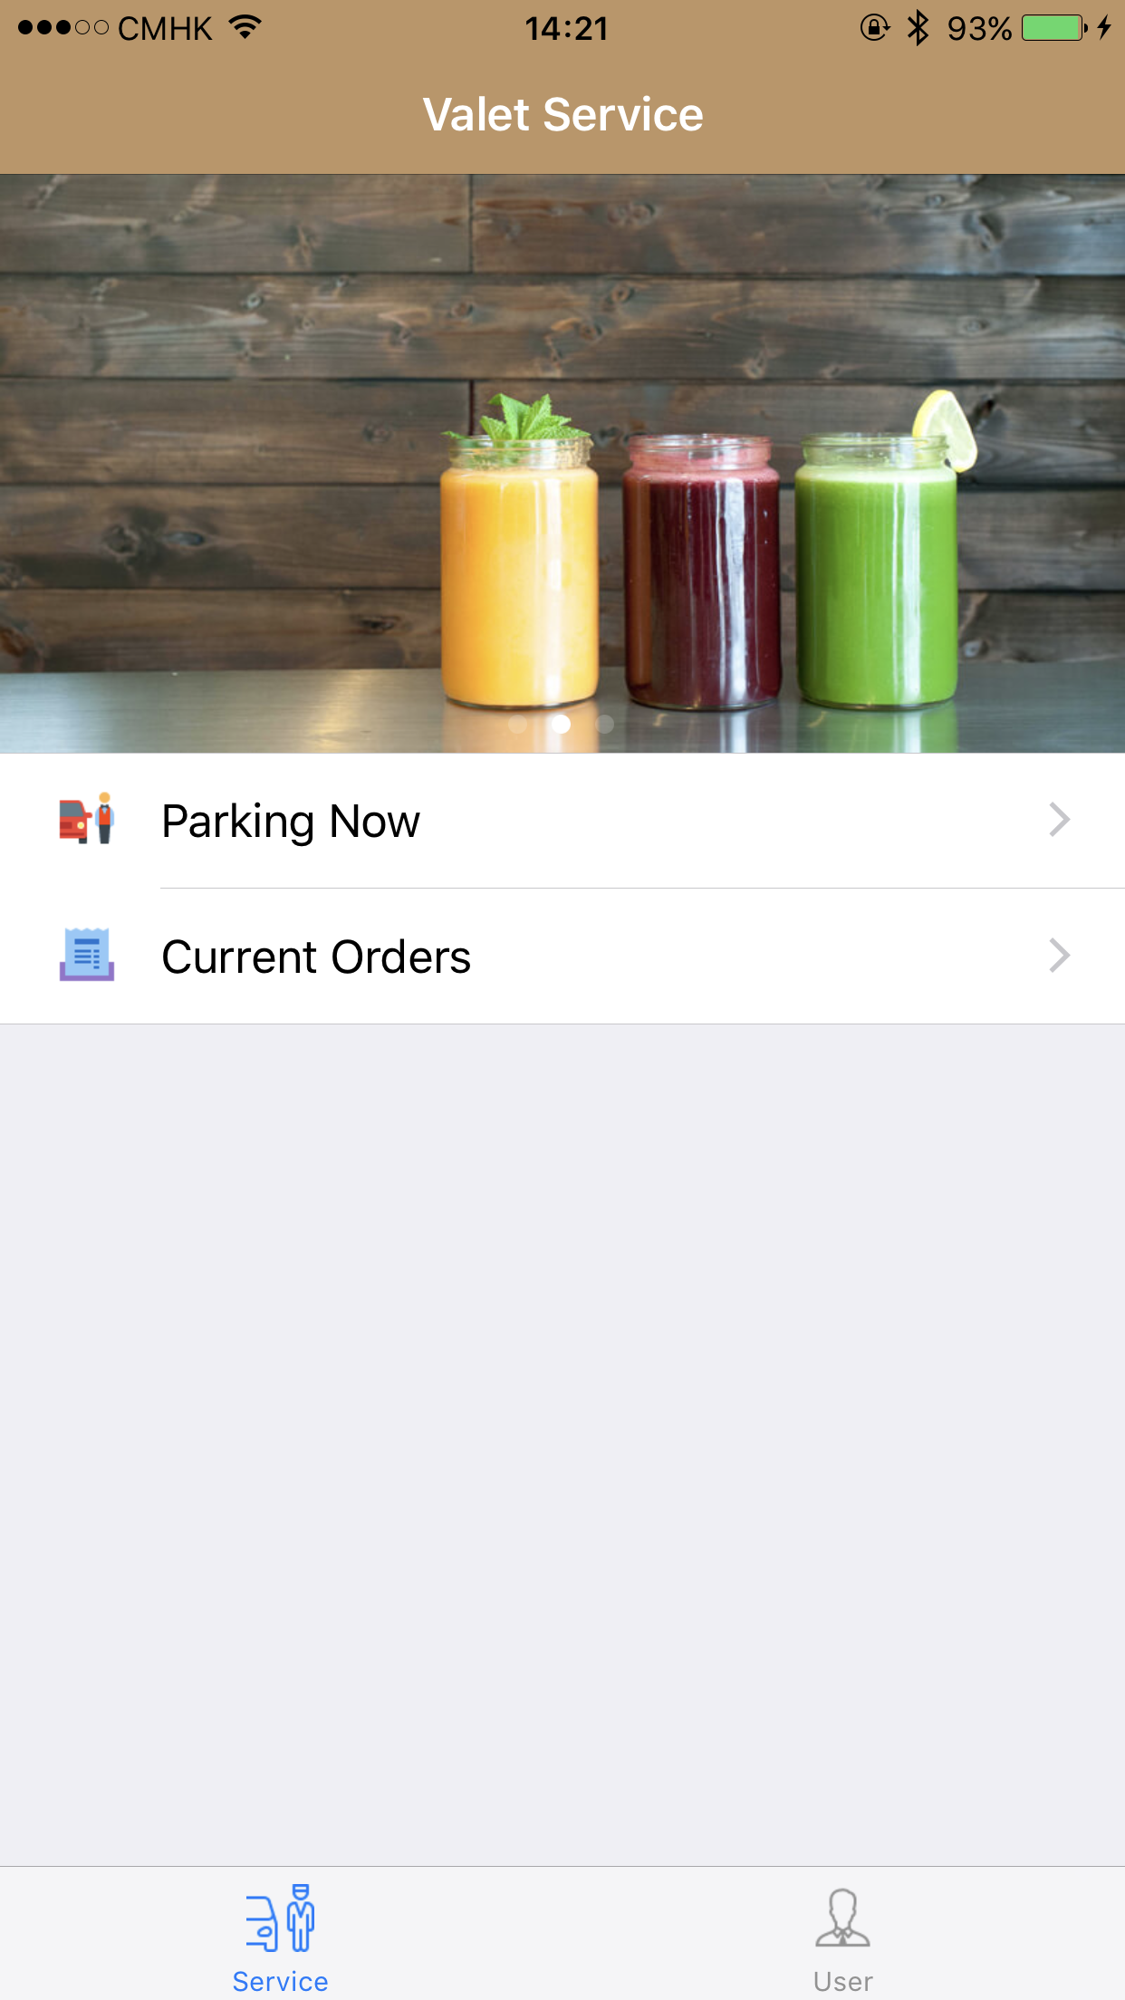
Views – Main Page

Slide 26
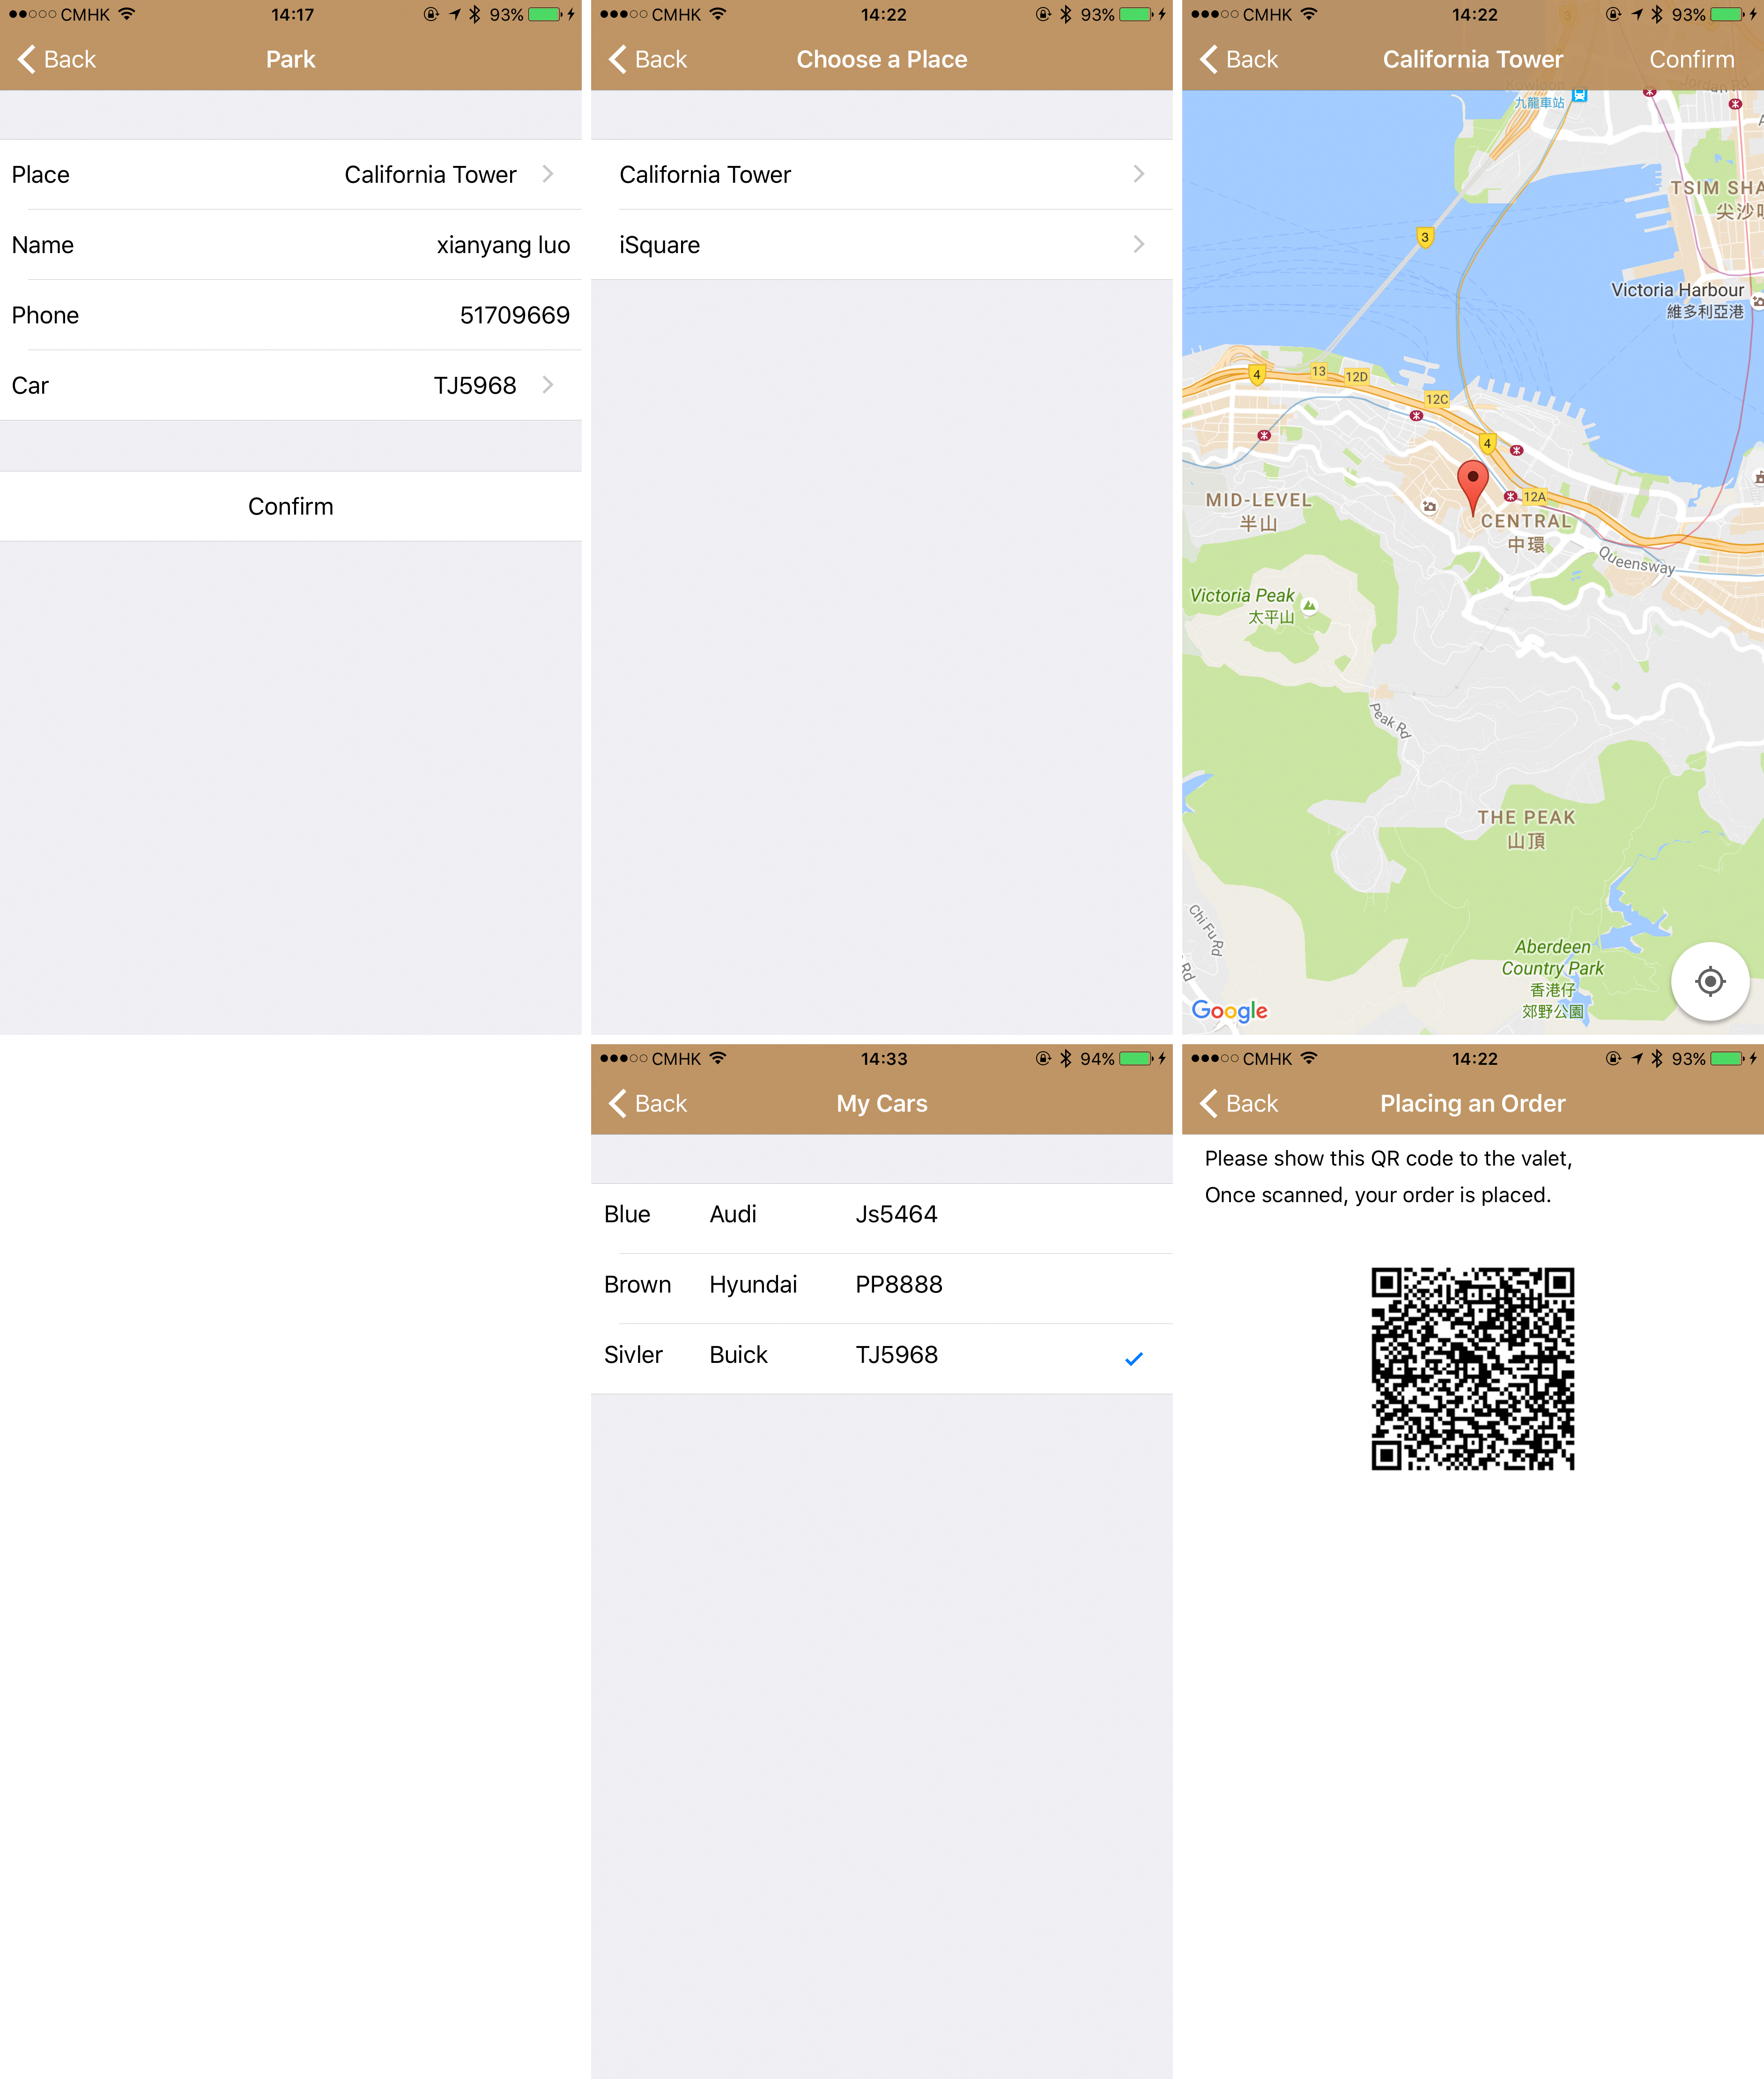
Views – Park a Car View

Slide 27
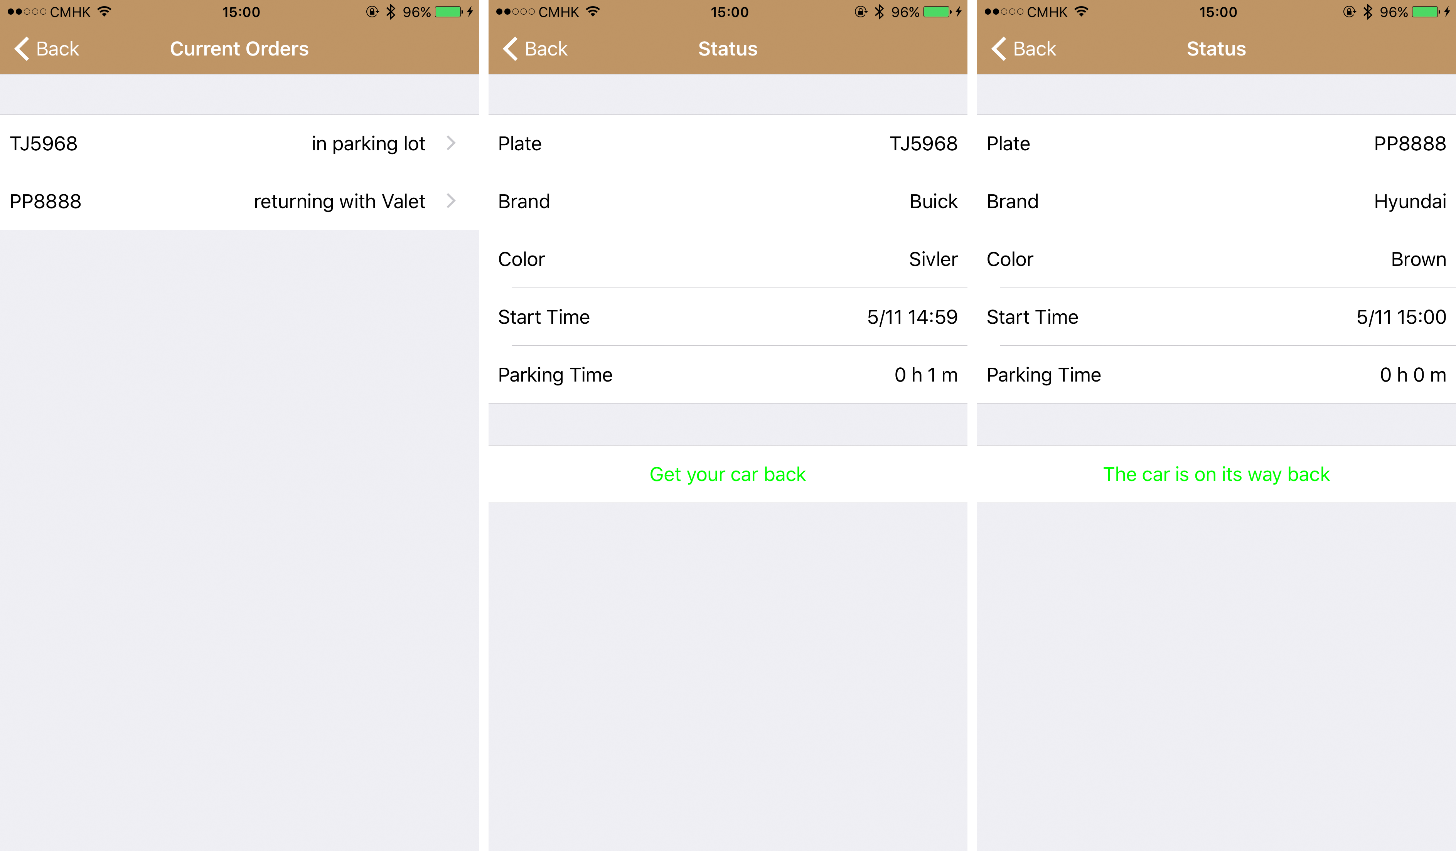
Views – Current Order View

Slide 28
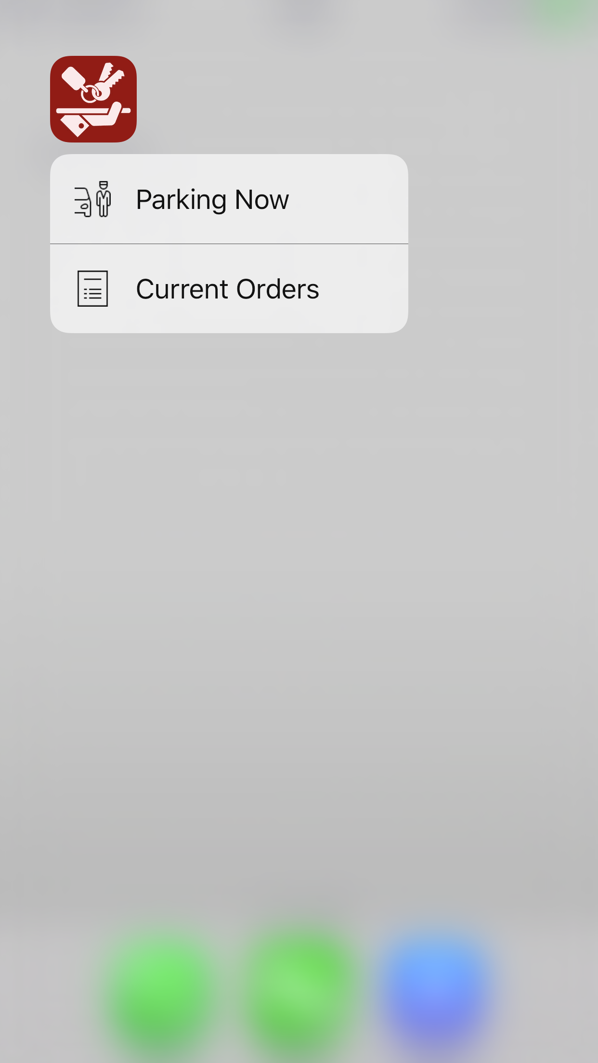
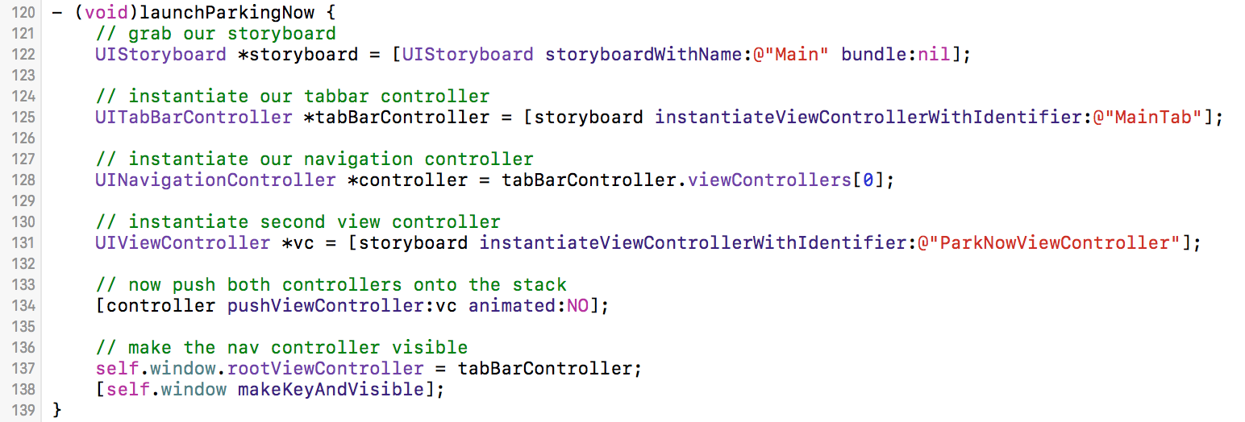
Views – 3D Touch View

Slide 29
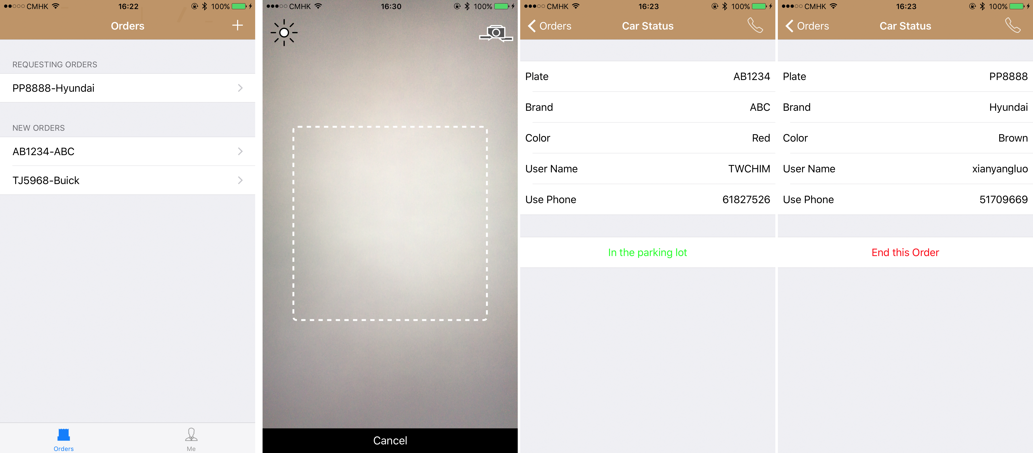
Views – Valet Client Main Views

Slide 30
Future Work
Mobile Payment
Apple Pay
Easier Process
Place an order automatically
Some additional service
Apple watch

Slide 31
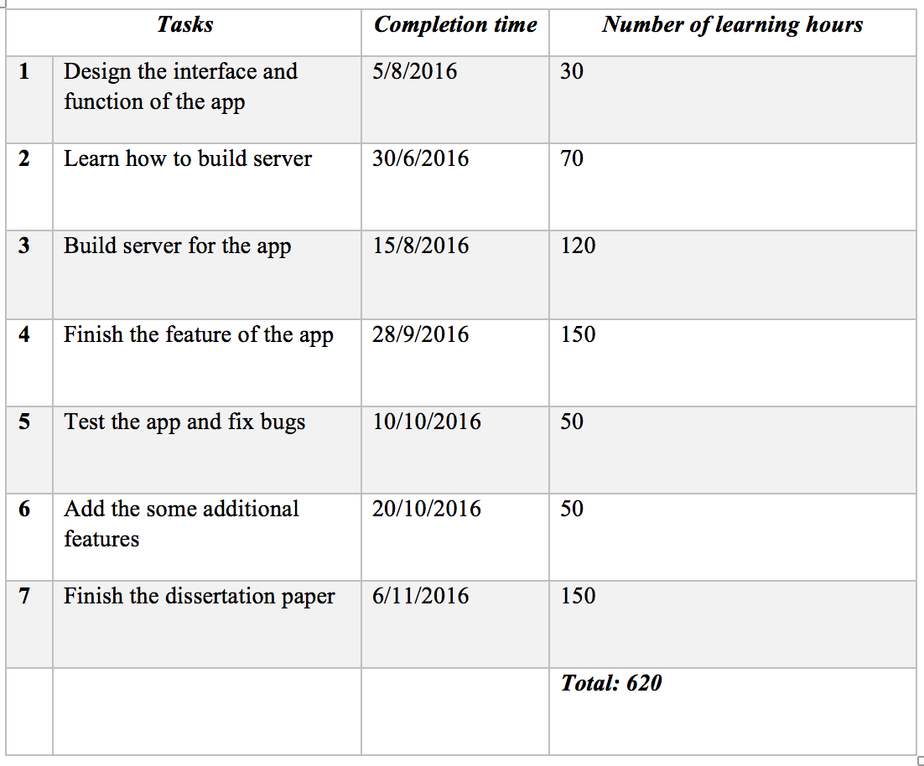
Learning Hours

Slide 32
Demo

